Slide 1






Ansible Roles
utrains.org

Slide 2
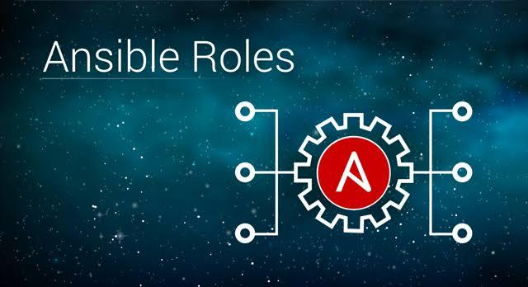
What is Ansible?

Slide 3
Table of content
Ansible roles
Ansible tower

Slide 4









Ansible roles
What is Ansible roles

Slide 5
What is Ansible roles?
Roles are a way to group multiple tasks together into one container to do the automation in very effective manner with clean directory structures.
Roles are a set of tasks and additional files for a certain role which allow you to break up the configurations.
It can be easily reused.
It can be easily modify and will reduce the syntax errors.

Slide 6
How do we create Ansible Roles?
HERE IS THE LINK TO THE CONFLUENCE PAGE ON HOW TO CREATE AN ANSIBLE ROLE (LINK)

Slide 7
Ansible tower
Ansible tower.

Slide 8
What is Ansible Tower?
Ansible Tower is a web-based solution that makes Ansible even easier to use for IT teams of all kinds. It’s designed to be the hub for all of your automation tasks.

Slide 9
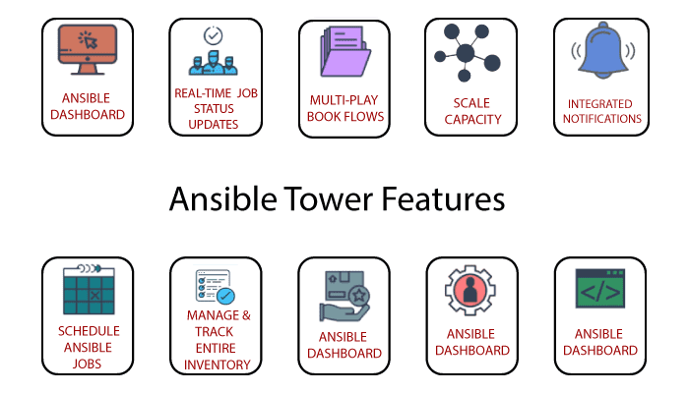

Slide 10
Important features of ansible tower
Some of the important features of Ansible Tower are listed below. The full feature list is available off the Ansible website.
Role-based access control: you can set up teams and users in various roles.
Job scheduling: schedule your jobs and set repetition options
Portal mode: this is a simplified view of automation jobs for newbies and less experienced Ansible users. This is an excellent feature as it truly lowers the entry barriers to starting to use Ansible.
Fully documented REST API: allows you to integrate Asible into your existing toolset and environment
Tower Dashboard: use this to quickly view a summary of your entire environment. Simplifies things for sysadmins while sipping their coffee.

Slide 11
Ansible Tower Editions
Ansible tower has three different editions as follows - self-support, standard, and the premium edition. They differ from each other on the basis of capabilities they offer. Let us have a look at the capabilities they possess.
 | Self support | standard | premium
Workflows | no | yes | yes
Built-in Notifications | yes | yes | yes
Ansible Tower Dashboard | yes | yes | yes
Real-time Job Outputs | yes | yes | yes
Remote Command Execution | yes | yes | yes

Slide 12
Ansible Tower Editions
 | Self support | standard | premium
Scale-Out Clustering | no | yes | yes
Documented API & Tower CLI | yes | yes | yes
24*7 Support | no | no | yes
Role-based Access Control | yes | yes | yes
Logging and Analytics Integration | no | yes | yes
Job Scheduling | yes | yes | yes

Slide 13
Ansible Tower Pricing
Is Ansible Tower free? As mentioned earlier, Ansible tower has three different editions. The first edition - self-support is a free trial version, but to use the other two versions you need to pay for it. Let us see how much.
For standard edition - $10,000/year for up to 100 nodes
Premium edition - $14,000/year for up to 100 nodes

Slide 14
Pros and Cons of Ansible Tower
What are the Advantages of Ansible Tower
Simple implementation by using readable YAML playbooks.
Natively has many modules that integrate with various software and technologies.
Automated deployment process
Great for sending out consistent changes to the group of servers
Agentless
What are the Disadvantages of Ansible Tower
There are still some modules that should be native but are not (MSSQL, Vault, etc).
Creating extensive logic in the playbooks is not as straight forward as other scripting languages.

Slide 15
We just saw an introduction to Ansible and Ansible roles and Ansible tower, please practice regularly to grasp the knowledge and read the Ansible documentation whenever you face any difficulties or simple to know more.

Slide 16
Read more
https://docs.ansible.com/ansible/latest/user_guide/playbooks_intro.html
https://docs.ansible.com/ansible/latest/network/getting_started/first_playbook.htmll
https://docs.ansible.com/ansible

Slide 17

Thanks!
Any questions?
You can find us at:
website: https://utrains.org/
Phone: +1 (302) 689 3440
Email: contact@unixtrainings.com

Slide 18
Click on the link below to contact the support team for any issue!
https://utrains.org/support/
Create a ticket for your problem and we will get back to you soon!

